Slide 1

CodeU Class 10 Welcome!
The class will start shortly
Reproduction and distribution of the presentation deck is prohibited

Slide 2
Agenda for today’s class
Recap of last class
01
02
Homework revision
We’ll revise the previous homework!
To refresh our minds!
Topic of the day:
03
04
Practice time!
We will practice different exercises!
Drawing shapes using Loops
Complex Turtle Exercises
Wrap-up
Conclusion
05
06
CodeU Robot
Summary of what we’ve learned today
Homework and questions

Slide 3

List of turtle methods (recap)
01
.penup()
.circle(x)
05
Pull the pen up so no drawing is made when the turtle is moving
Draws a circle with the radius x
02
.pendown()
.color(“blue”)
06
Pull the pen down to start drawing when the turtle is moving
Changes the color of the line. See next slides for colors
03
.goto(x, y) or .setpos(x,y)
.shape(“arrow”)
07
Moves the turtle to the position x,y
Changes the tip of the turtle to another shape. See next slides for more shapes.
04
.speed(”slow”)
.pensize(x)
08
Changes the speed of the turtle. Can use “slow”, ”fast”, “fastest”
Changes the thickness of the line to width x.

Slide 4
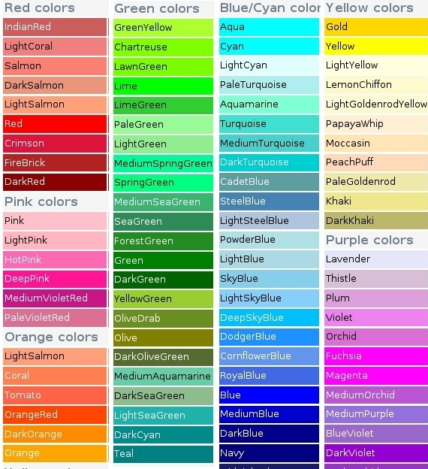
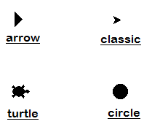
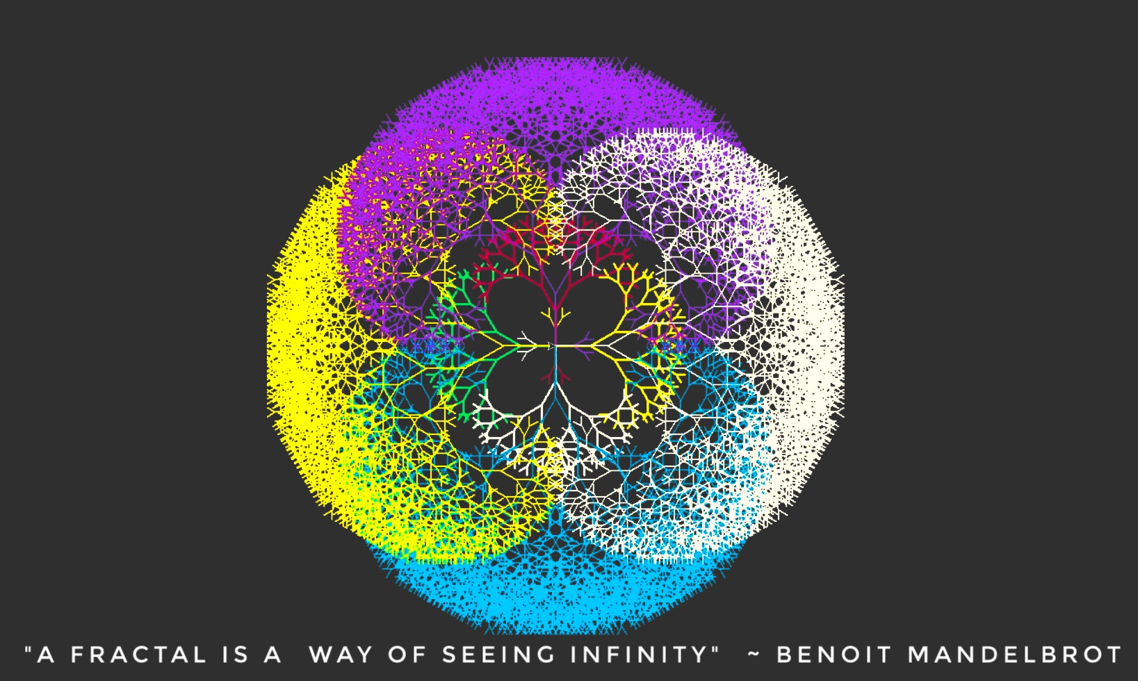
Shapes
Colors
Colors and Shapes
“arrow”
“turtle”
“circle”
“square”
“triangle”
“classic”

Slide 5
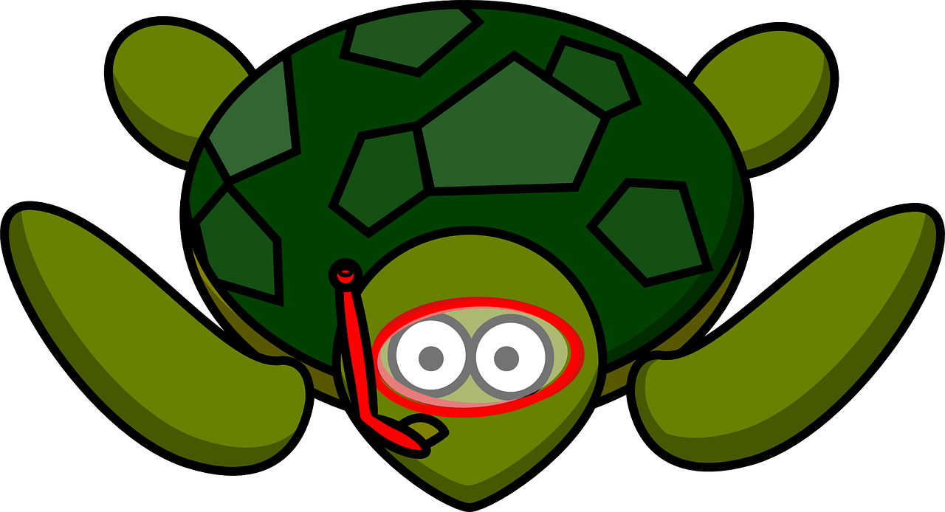
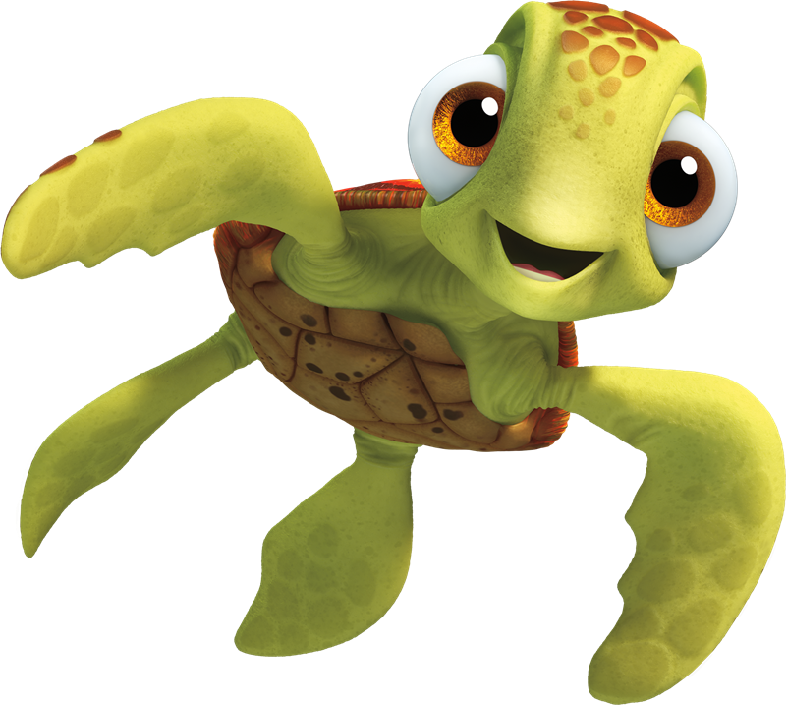
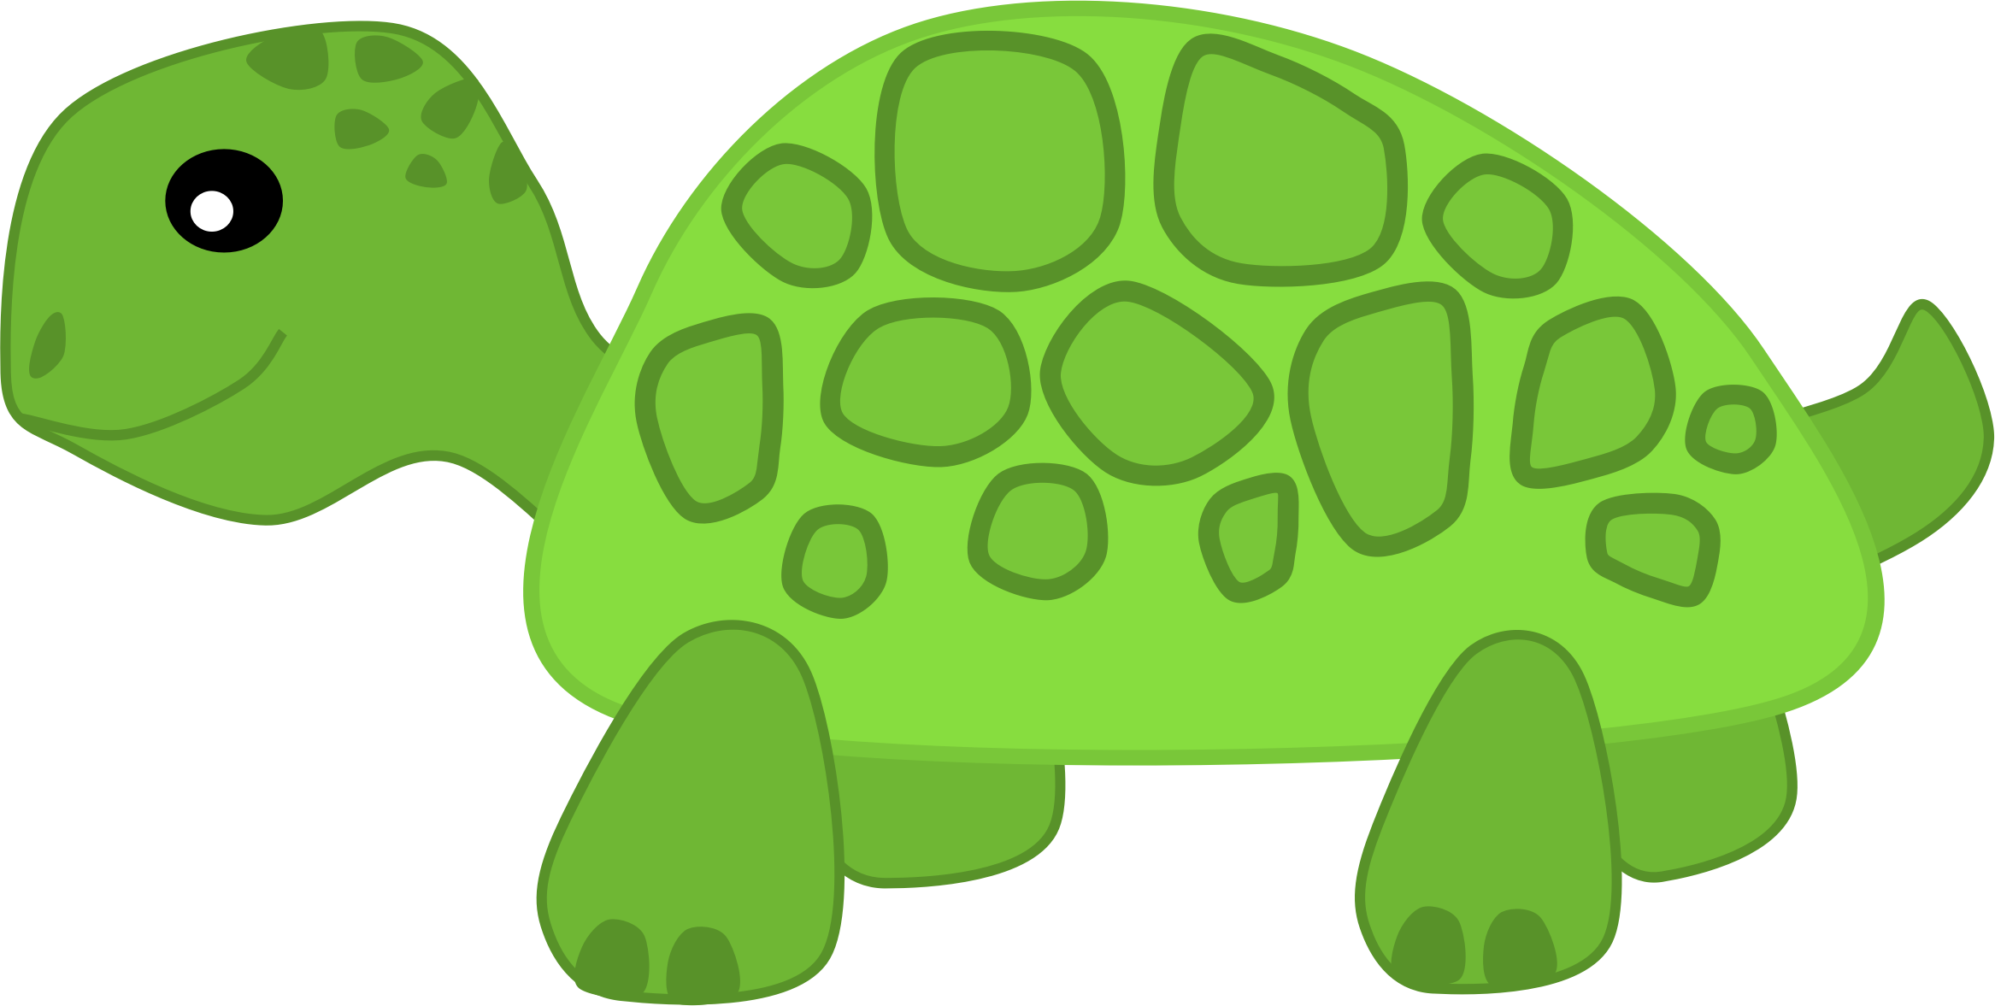
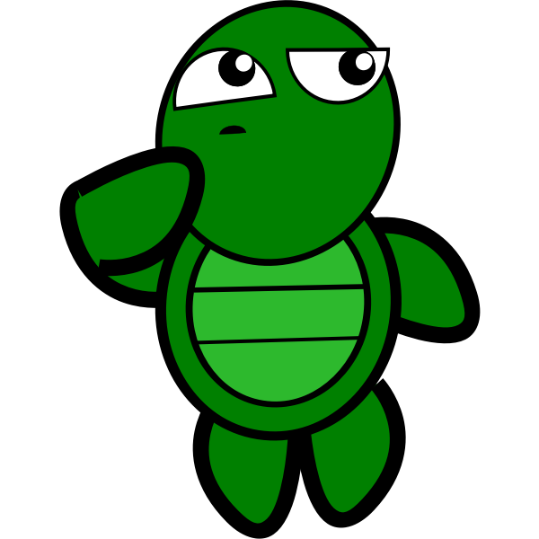
Drawing shapes efficiently!
01
03
Draw a Hexagon!
Draw a Triangle!
for i in range(6):
p1.forward(100)
p1.left(60)
for i in range(3):
p1.forward(100)
p1.left(120)
02
04
Draw a Star!
Draw a Square!
for i in range(8):
p1.forward(100)
p1.left(135)
for i in range(4):
p1.forward(100)
p1.left(90)

Slide 6
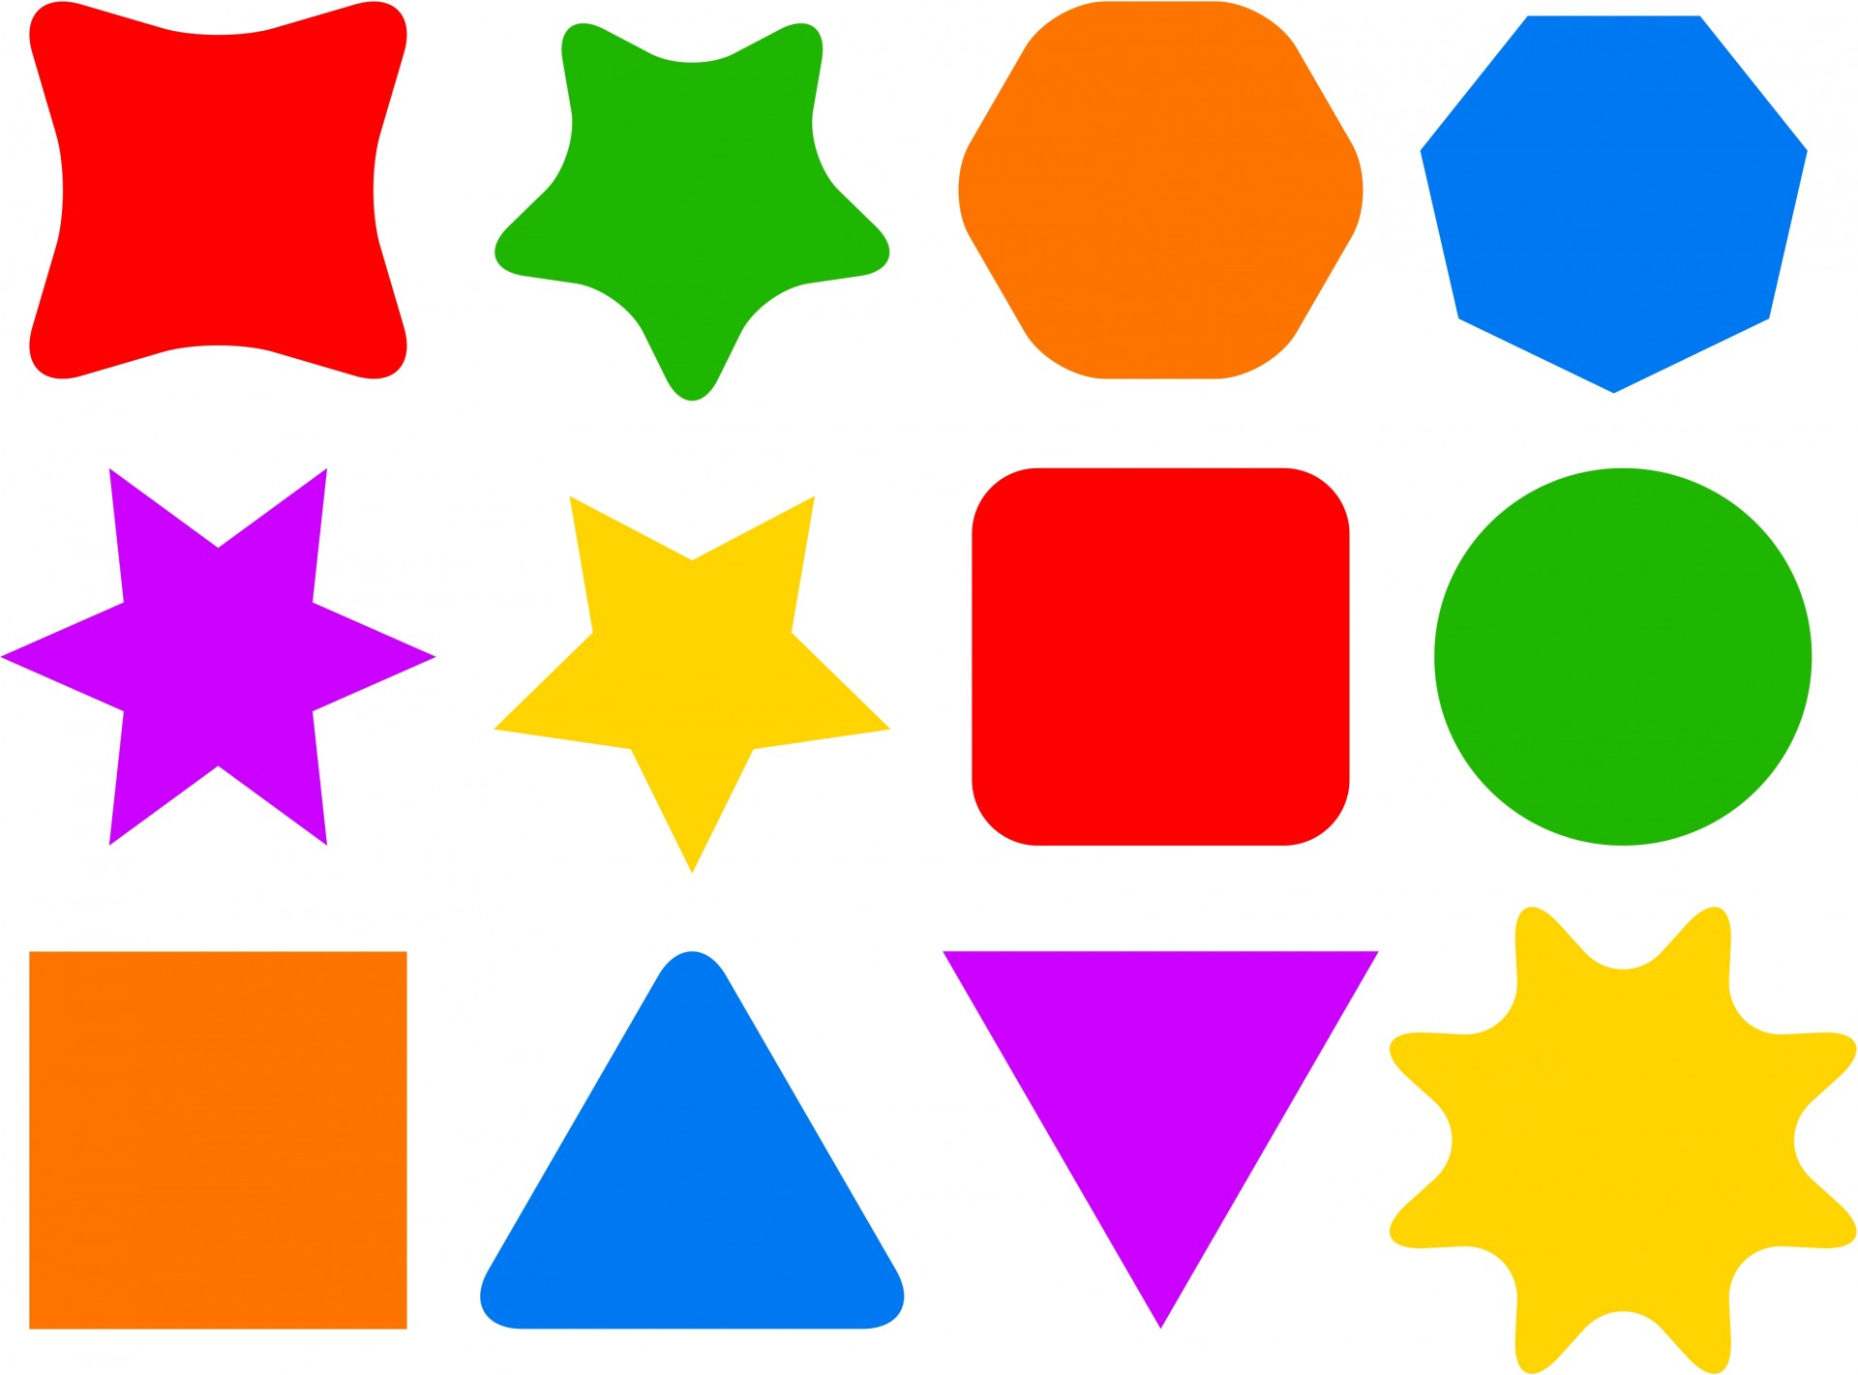
Choose your shape!
05
Steps:
Create a while Loop that loops forever until broken.
Inside the loop, create 3 different variables using input: one for the choice of shape, one for the outline color and another for the inside color of the shape.
Define the outline and inside pen colors using the input variables.
Create conditionals for all possible shapes.
At the end of the Loop, create a variable using input asking the player if they want to keep playing. If they do, then the loop continues. If they don’t, the loop breaks.
Description
You can choose to draw a variety of shapes with different colors!
Colors
Blue, green, yellow, red, pink, brown, beige, and many more!
Shapes
Circle, triangle, square, rectangle, hexagon, and star.

Slide 7

Abstract Art with circles!
05
Description
You must create an abstract art painting where you will draw circles of different radiuses, different outline colors, different inside colors, and different positions on the canvas. Each element must be determined randomly!
Step 1
Create a FOR Loop that repeats as many times as you want circles on your drawing!
Step 2
You must set your colors using random.randrange(). You will select a random color for your outline AND for your inside color from a given list of colors./
Step 3
Set a random X position and a random Y position for the current circle using random.randrange() where it will select a random value from -250 to 250.
Step 4
Draw your circle with a random radius using random.randrange() where it will select a random value from 10 to 18.

Slide 8

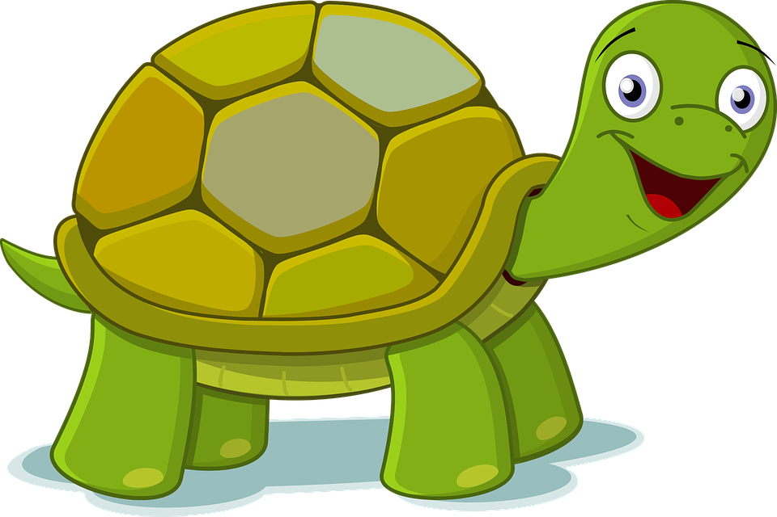
Homework: Build your house!
Homework Description
The mayor of your town has asked you to draw a sketch of a house to determine what types of houses he should build in the city! The house can be of any shape or form, any color, and any size. However, there are a few requirements.
Requirements:
The house must have a ROOF(triangular, etc.)
The house must have a DOOR(rectangle, circle, square, etc.)
The house must have at least 1 WINDOW(circle, square, etc.)
01
Create your pen: pen size, speed, shape, etc.
03
Set a starting position when drawing an element. Don’t forget penup() and pendown() when moving your pen!
02
Set an outline color and a fill color for each element of your drawing. (Ex.: Door)
04
Draw the element in the most efficient way.

Slide 9
Homework Solution: Build your house!
# Position
h1.penup()
h1.goto(-112,80)
h1.pendown()
# Triangle Roof
h1.begin_fill()
for i in range(3):
h1.forward(225)
h1.left(120)
h1.end_fill()
## WINDOW ##
# Color
h1.color("black", "beige")
# Position
h1.penup()
h1.goto(20,0)
h1.pendown()
# Square Window
h1.begin_fill()
for i in range(4):
h1.forward(55)
h1.left(90)
h1.end_fill()
# Create your pen
h1 = turtle.Turtle()
h1.pensize(6)
## House ##
# Color
h1.color("black", "orange")
# Position
h1.penup()
h1.goto(-100,-100)
h1.pendown()
# Square House
h1.begin_fill()
for i in range(4):
h1.forward(200)
h1.left(90)
h1.end_fill()
## ROOF ##
# Color
h1.color("#573f2b", "firebrick")
## DOOR ##
# Color
h1.color("black","brown")
# Position
h1.right(90)
h1.penup()
h1.goto(-60,-100)
h1.pendown()
# Rectangle Door
h1.begin_fill()
for i in range(2):
h1.forward(50)
h1.left(90)
h1.forward(100)
h1.left(90)
h1.end_fill()
turtle.done()

Slide 10



Thank you!
Does anyone have any questions?
Next class: class 11!
Phone:
(438) 391-9106
Please contact us to make any change in the schedule for the next class.
Email:
siva.sri14@hotmail.com
hello@codeu.ca
Website:
https://www.codeu.ca/
Reproduction and distribution of the presentation deck is prohibited

